Slide 1
Welcome to Week Three
The Kingdom of God is within you
Luke 17:21

Slide 2
Life in the Spirit
The Sacrament of Confirmation consists of the renewal of baptismal promises and the laying on of hands and anointing with the oil of Chrism. The anointing of the candidate is a sign of confirming the gift of the Spirit, and calling the candidates to use these gifts to become involved in the life and mission of the community.
We are reminded of our participation in the ministry and mission of Jesus, and strengthened to follow Jesus more closely.

Slide 3
The Parable of the Mustard Seed
“The Kingdom of God is within you”
Luke 17:21

Slide 4
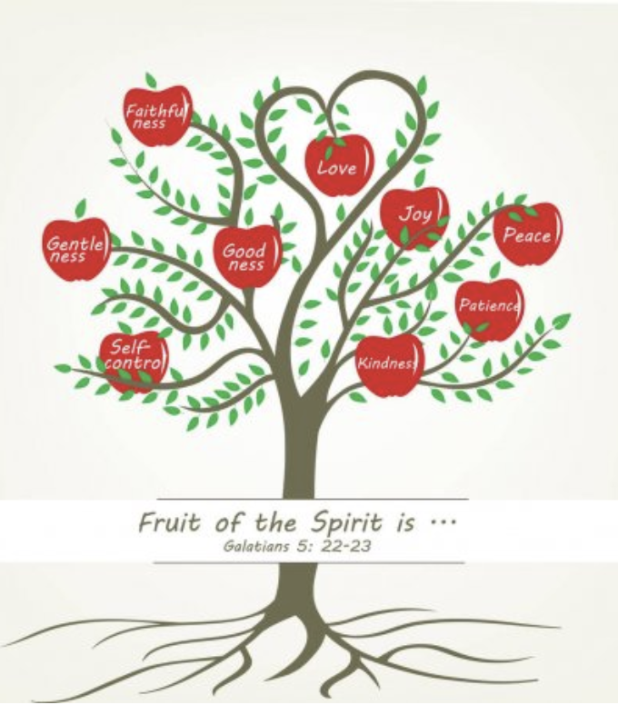
Fruits of the Spirit

Slide 5
The Parable of the Sower

Slide 6
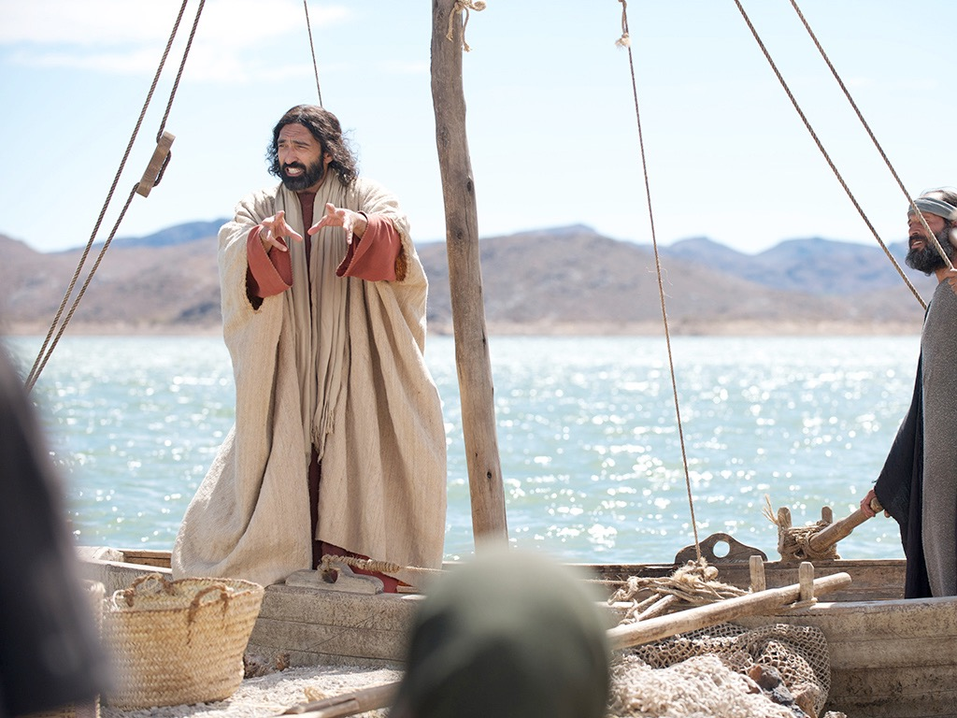
Free Bible Images

Slide 7
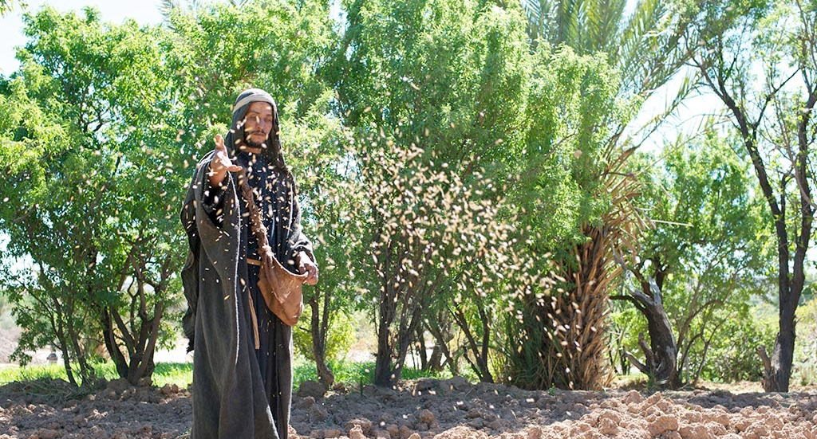

Slide 8
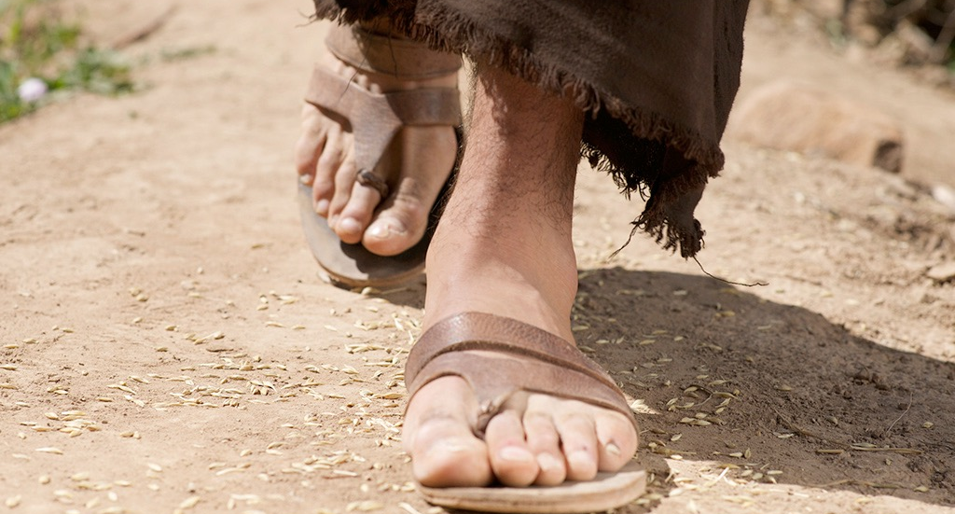

Slide 9
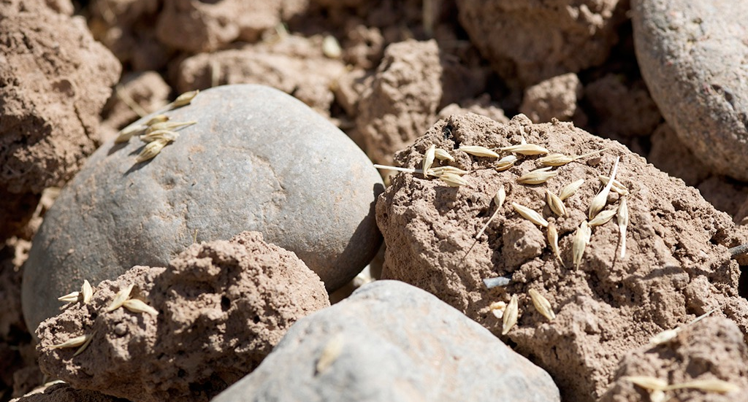

Slide 10
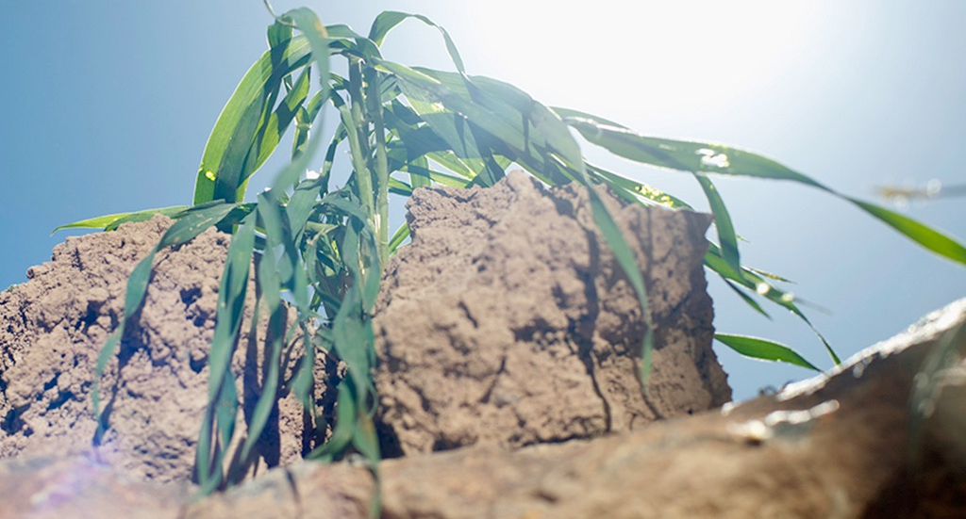

Slide 11
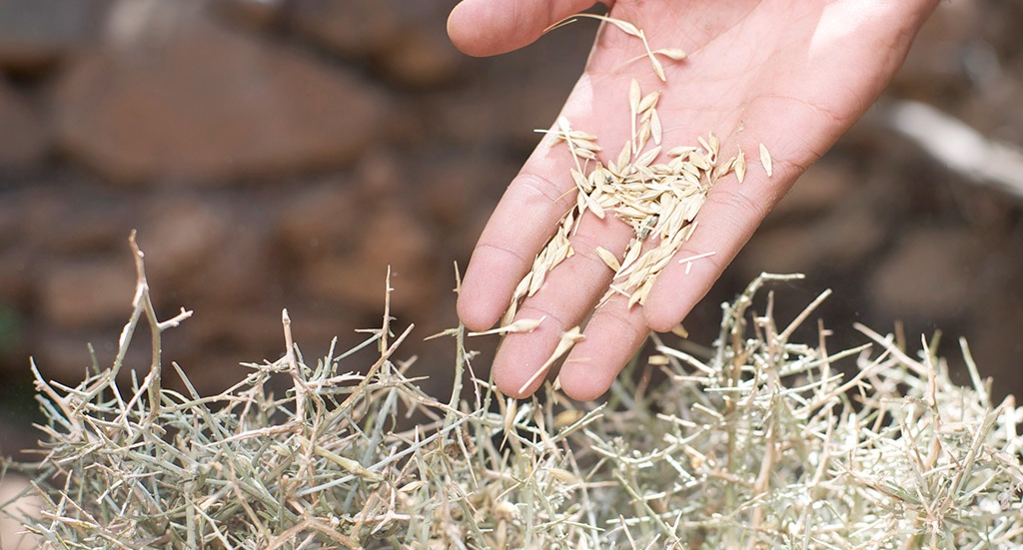

Slide 12
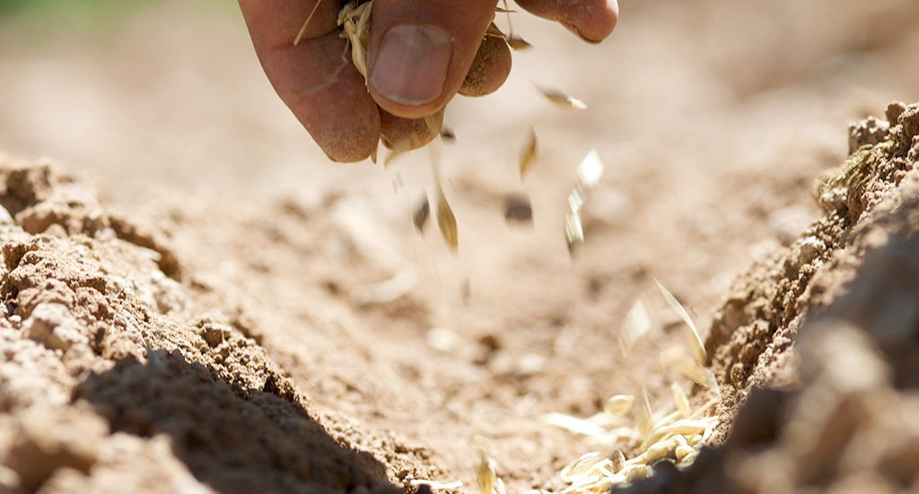

Slide 13
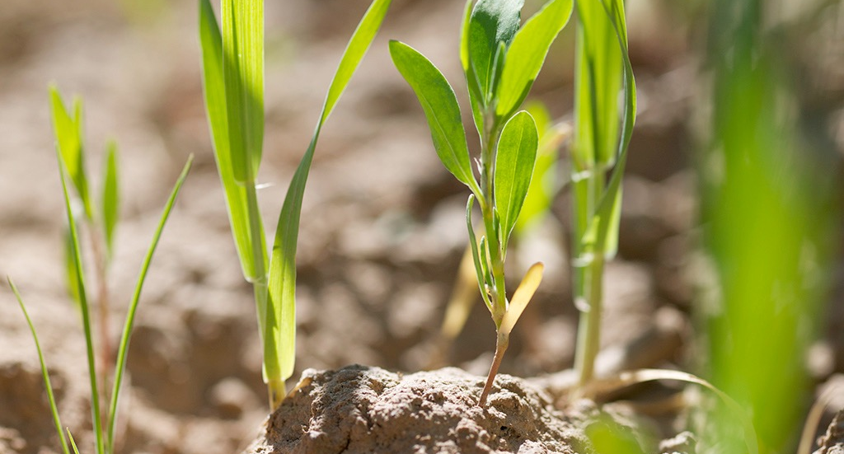

Slide 14
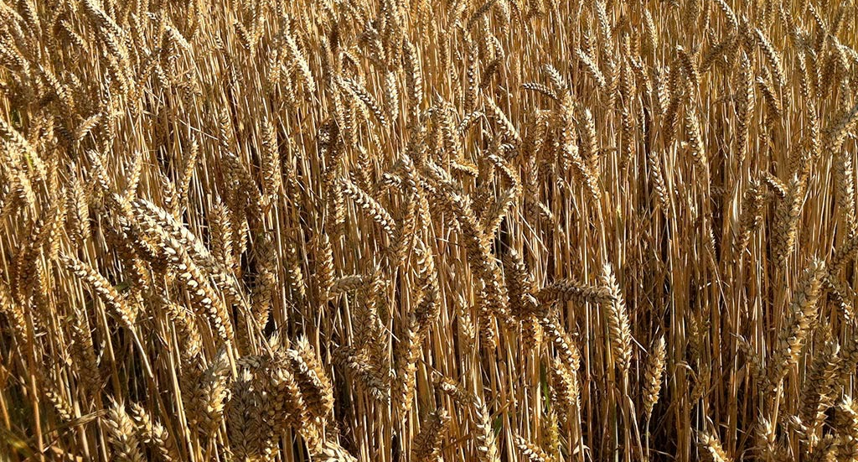

Slide 15
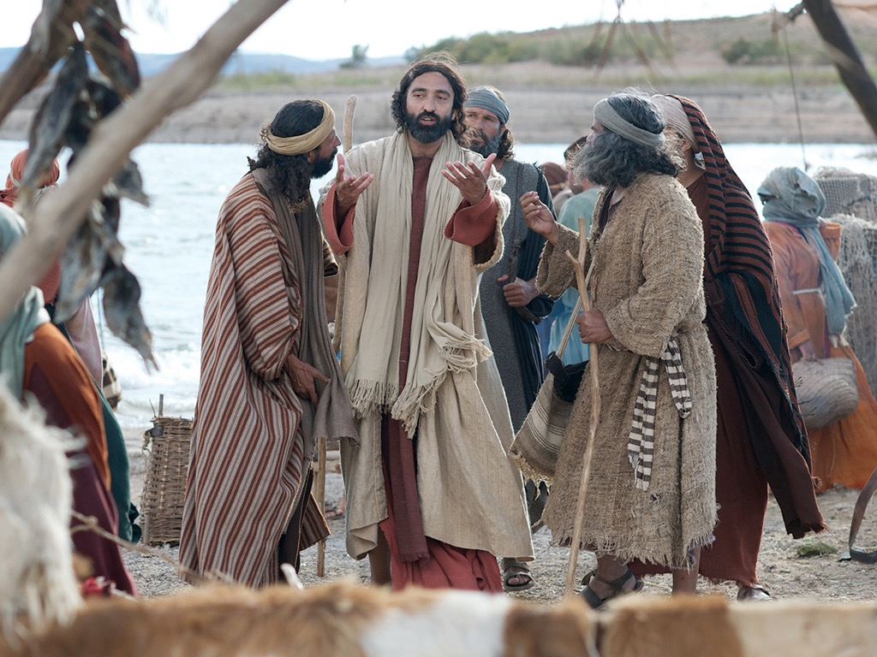

Slide 16
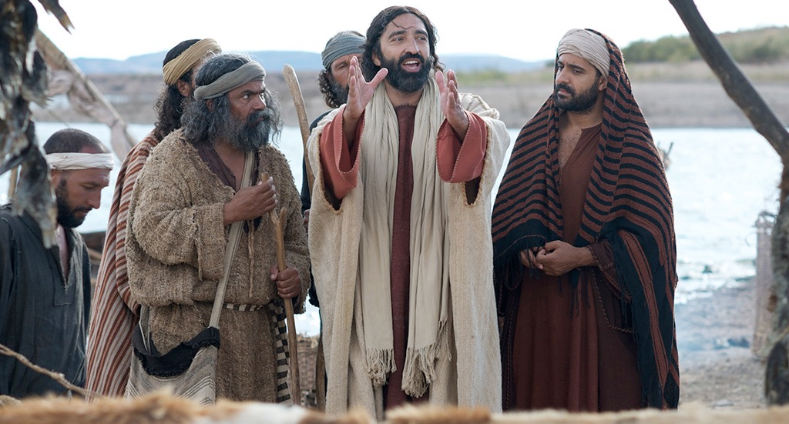

Slide 17
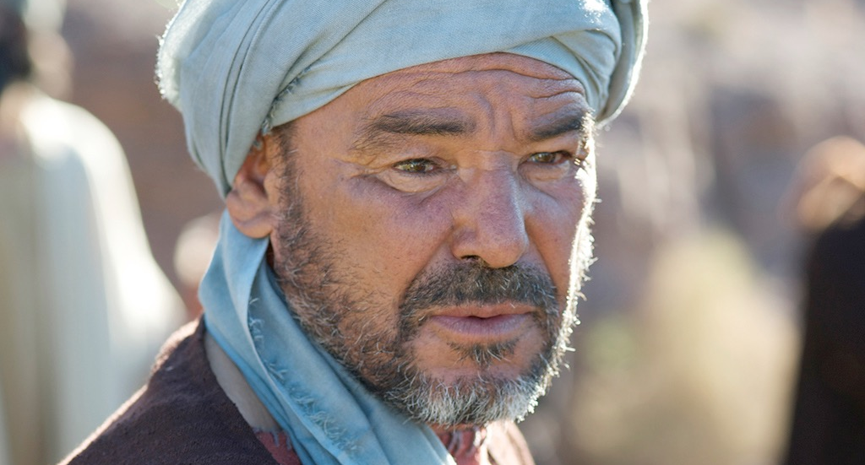

Slide 18
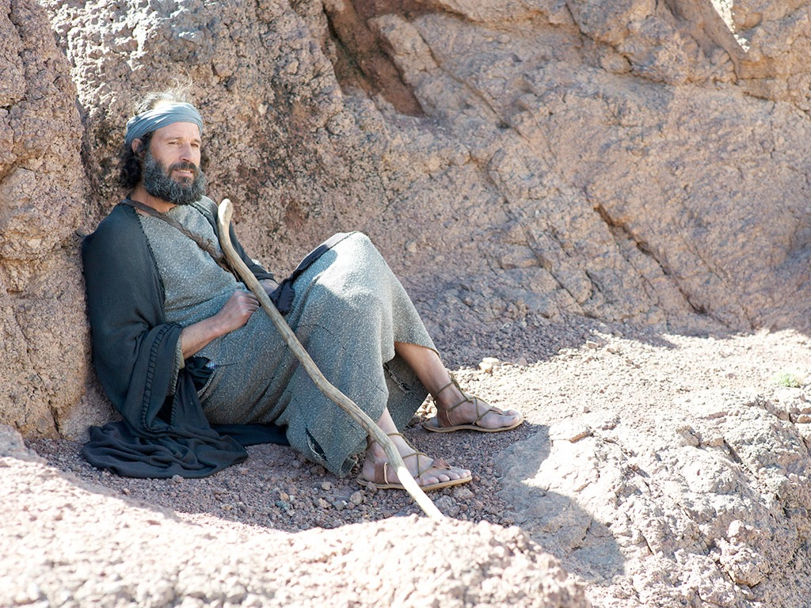

Slide 19
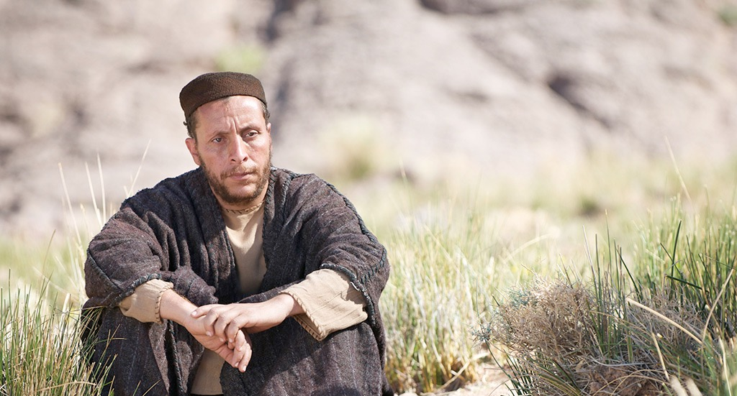

Slide 20
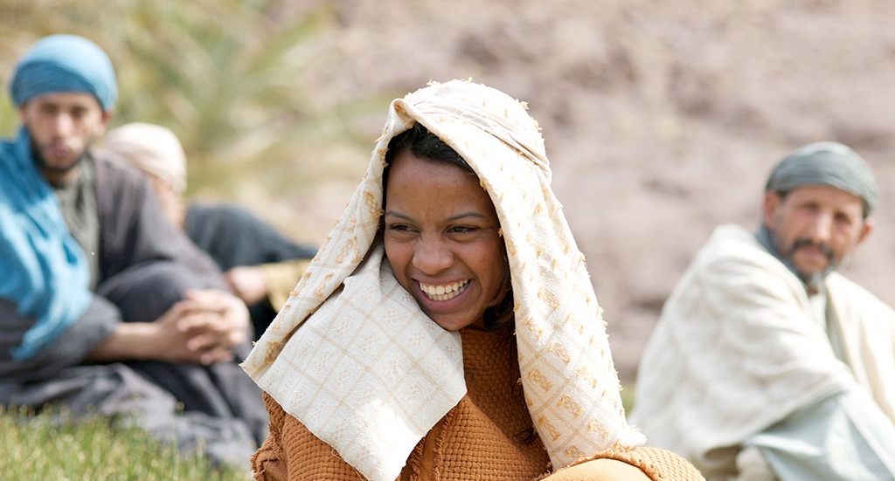

Slide 21
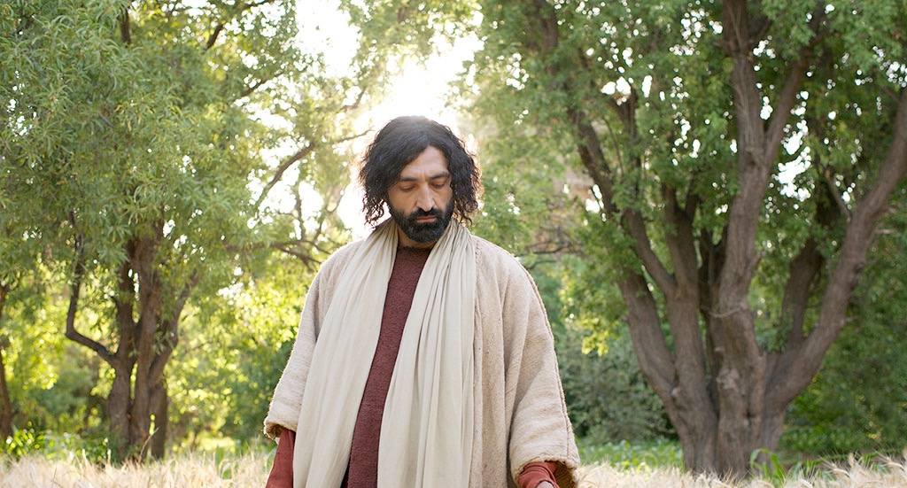

Slide 22
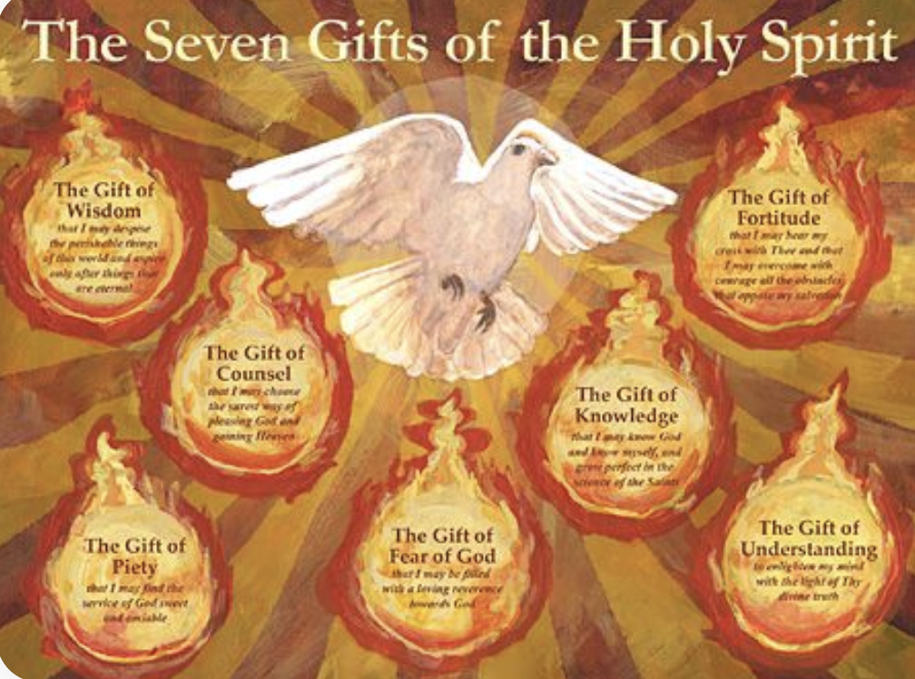

Slide 23
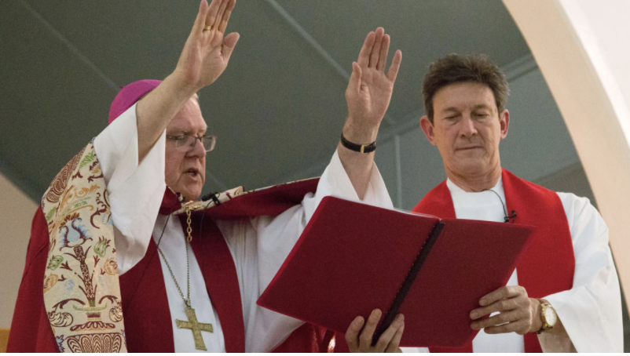
Praying with Hands
Laying on of Hands
During Confirmation, the bishop places his hands on the head of the candidates and prays for the gifts of the Holy Spirit.
This ritualises the connection to Baptism and the strengthening of the Holy Spirit in our vocation to follow the way of Jesus.

Slide 24
Activities to do at Home

